Slide 1
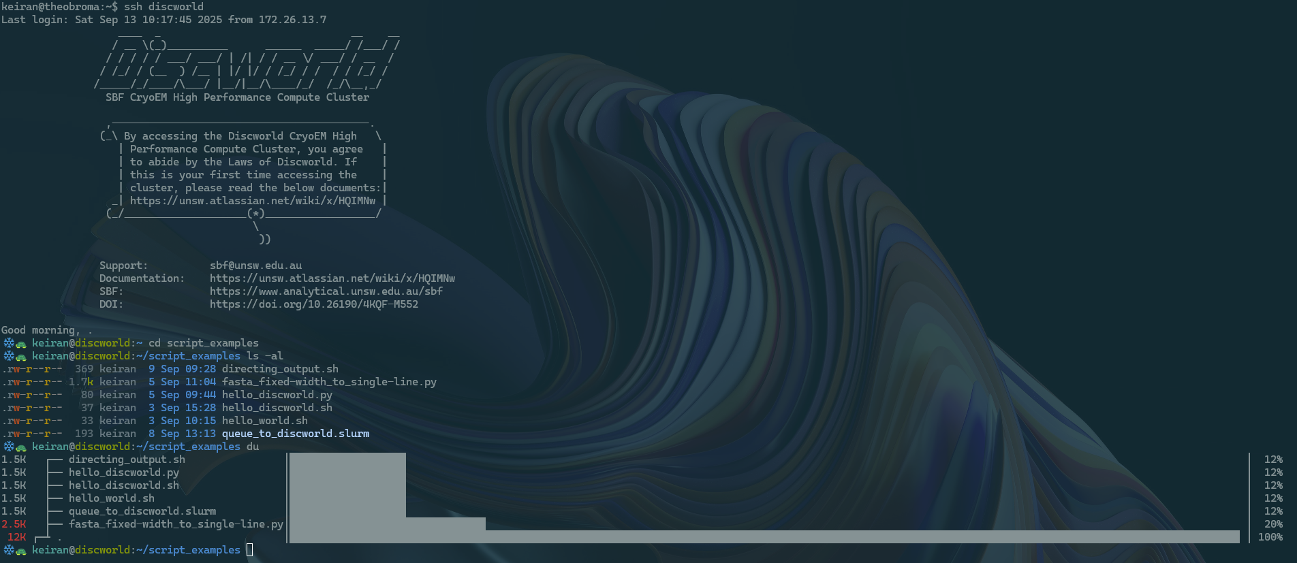
Command Line (CLI) BioSciences
Make your science easier with high performance computing (HPC)
Dr Keiran Rowell & Nathan Glades - Digital Health Hub, UNSW - Run 2 - 14th January 2026​

Slide 2
HPC
Why leave your laptop? When you have to: Data, Silicon, Time, $$
You are escaping:
Wait, which desktop hard drive did I leave my data on?
My calculations don't finish before the power saver kicks in.
It takes me days to install all the programs I need.
My computer just isn't powerful enough for all the data I've gathered.
I can't access my work off-campus.
So you can do your science:
I can get help for difficult to install programs!
I can share my work and scripts with scientists doing the same thing.
I can save work hours by not manually doing the same thing.
I can use the power of industrial-grade computers linked together.
I can let the scheduler handle running my jobs and go do something else.

Slide 3
Text interfaces: efficiency, automation, adaptability
ssh
The command line is a starting barrier because there's no visual feedback
It will be silent if things 'just work'​
Otherwise, it will throw back error messages to the terminal
Error messages are highly specific, which means we can solve our problems
Can write down exactly what to do into a shell script (.sh)

Slide 4
Text interfaces: a blank page means things are simple
ssh
All text can be edited (we've made the edit command)
Everything is a file
The permissions of each file can be controlled
Managing data is faster
You can automate recipes (shell scripts .sh) of other scientists
tldr program or program --help tells you usage info

Slide 5
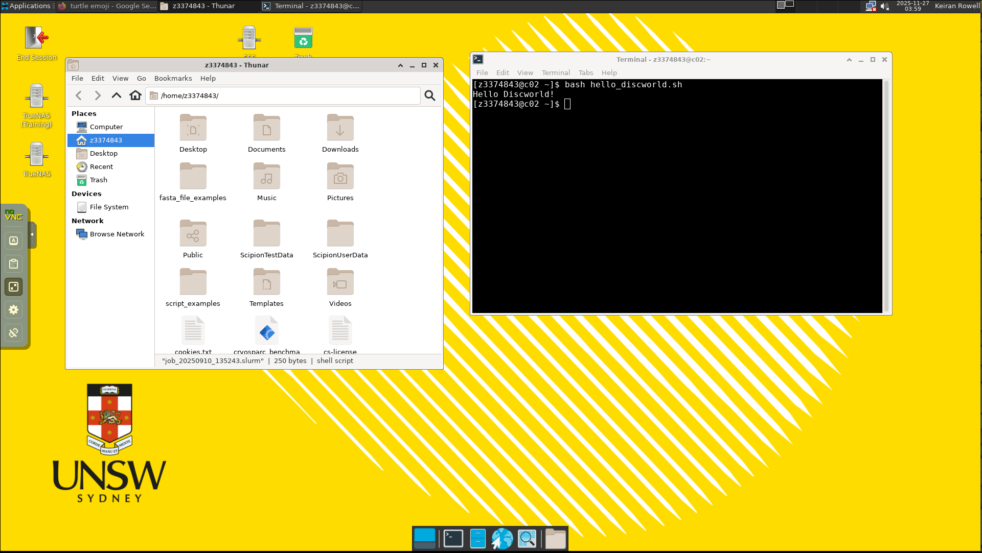
sdesktop
Graphical interfaces: interaction, structures, inspection
Science is visual
'desktop': successful computing metaphor
3D molecules
Image analysis requires user choice

Slide 6

sbatch
Pooled resources: 'set-and-forget', 24x7, scalable, powerful
Hardware pooled — request your bucket
Dip your toe in before the highboard
Testing (start small):
Memory
Time per data size
CPU cores
GPU processing
Trial in an interactive job
The scheduler will keep your job in its lane

Slide 7
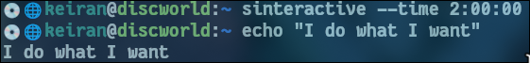
sinteractive
Interactive requests: testing, debugging, trials, flexible
Interactive jobs give you a 'live' terminal while still contained in its lane.
Great for anything you haven't figured out yet.
The graphical sdesktop is still contained inside an interactive job.
Once constructed, hand your job off to the scheduler.
A watched pot never boils

Slide 8
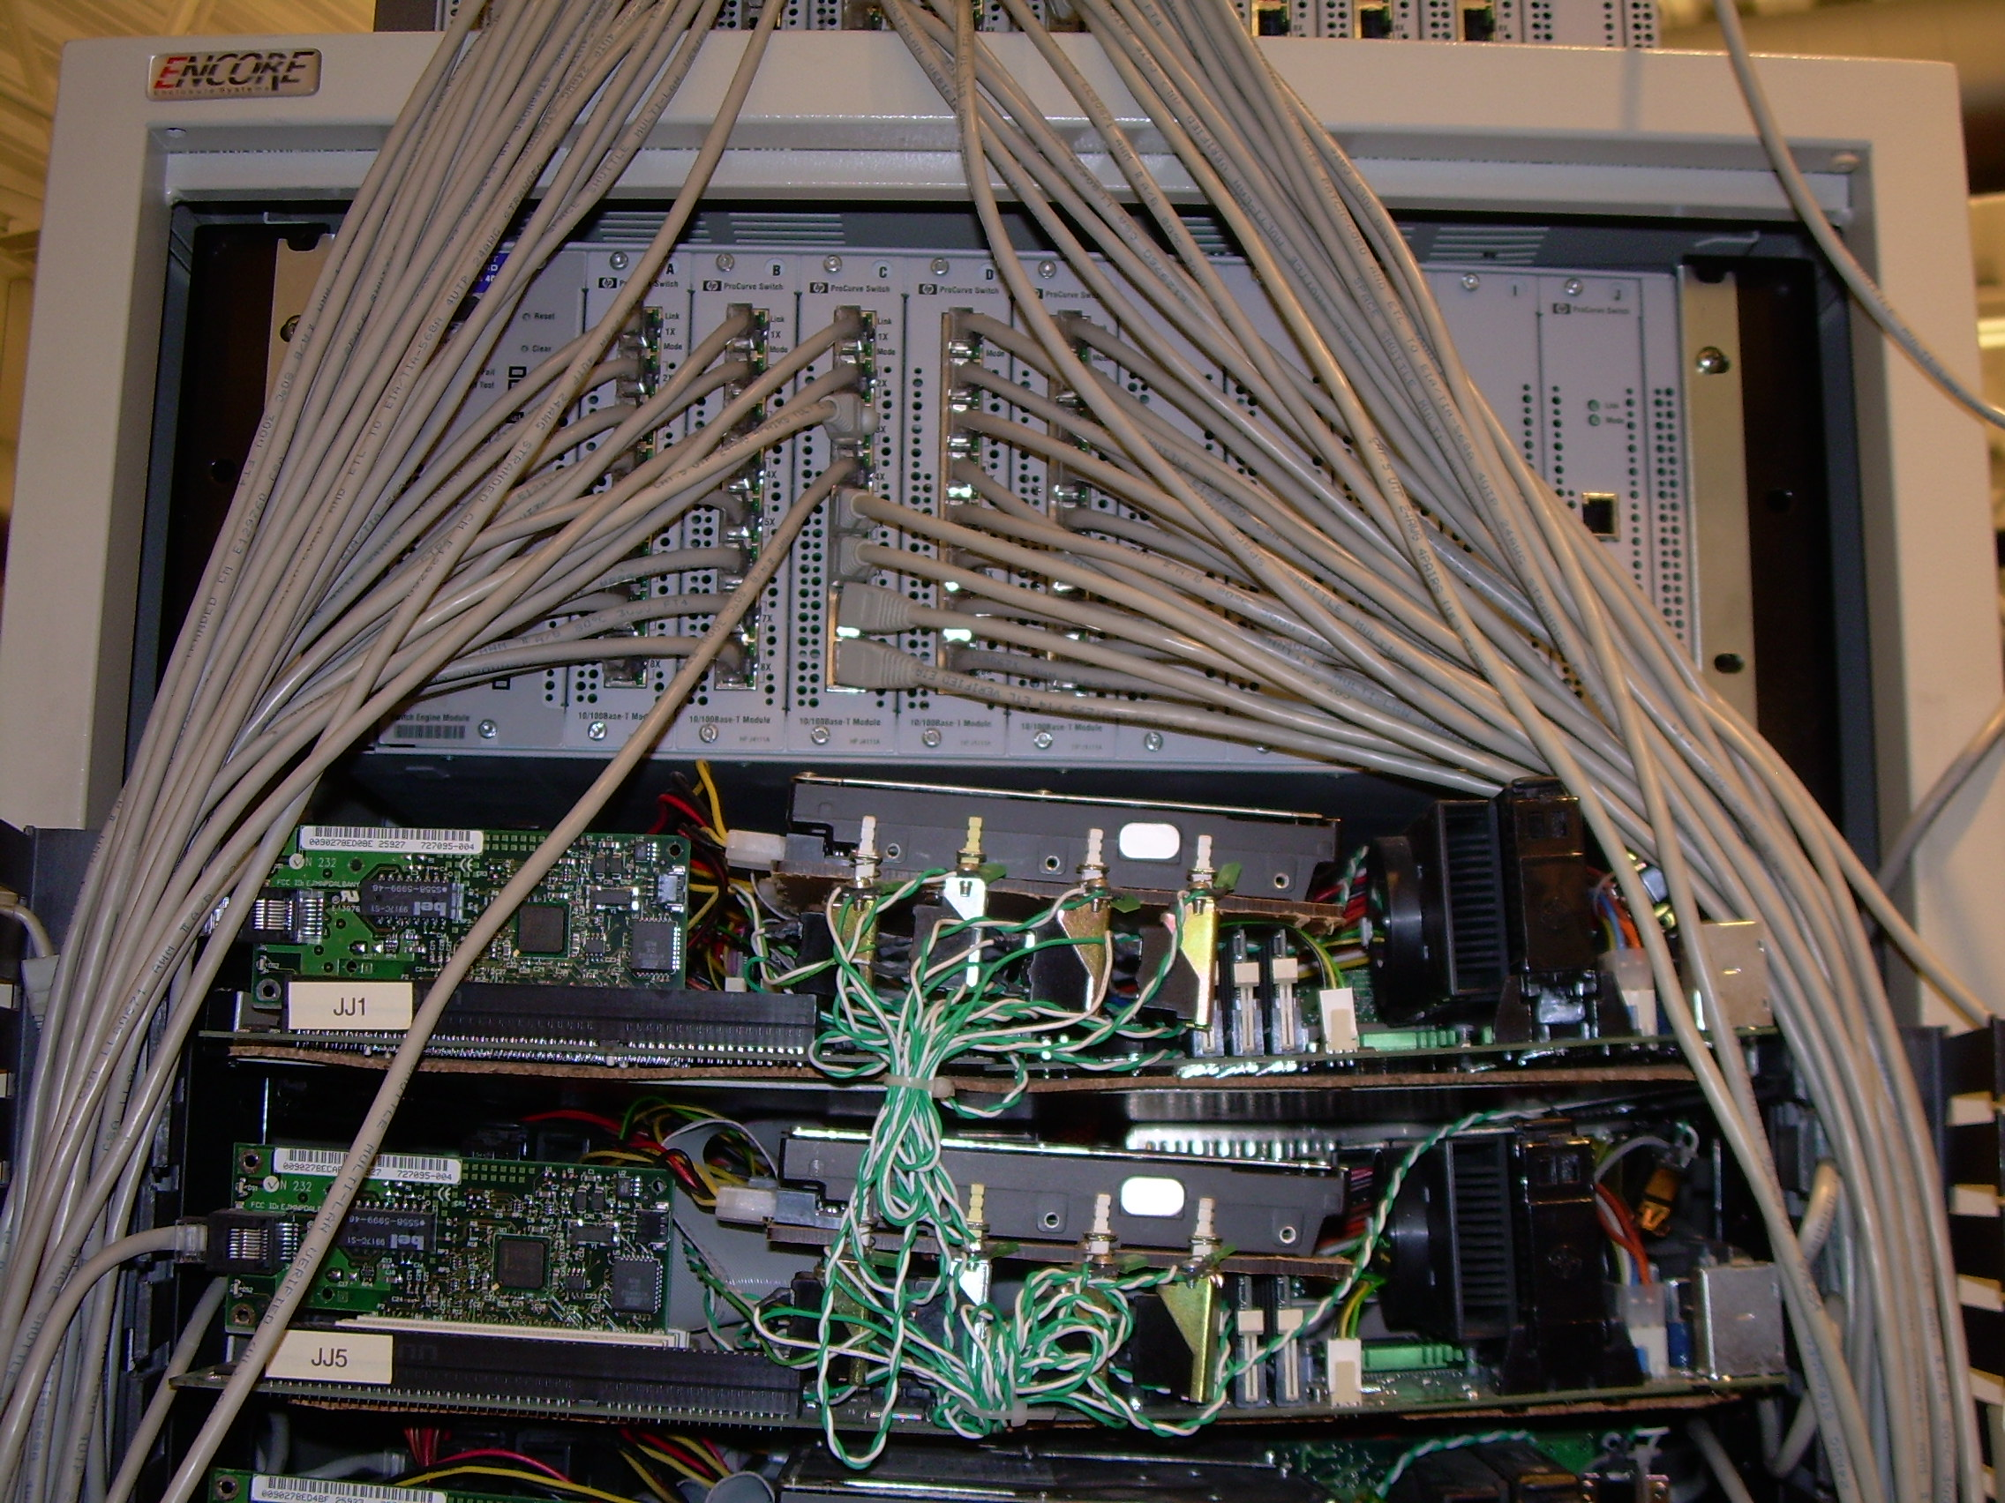
sdraft
Resource requests: job time, memory, cpus, gpus
Don't worry about model compatibility
That's for the computer engineers
Think about how your science:
Scales – doubles, squared?
Runs – Parallel, sequential?
Size – memory, disk space?
Source: Carlo Nardone, Computer Museum: First Google Cluster rack (detail of networking)

Slide 9
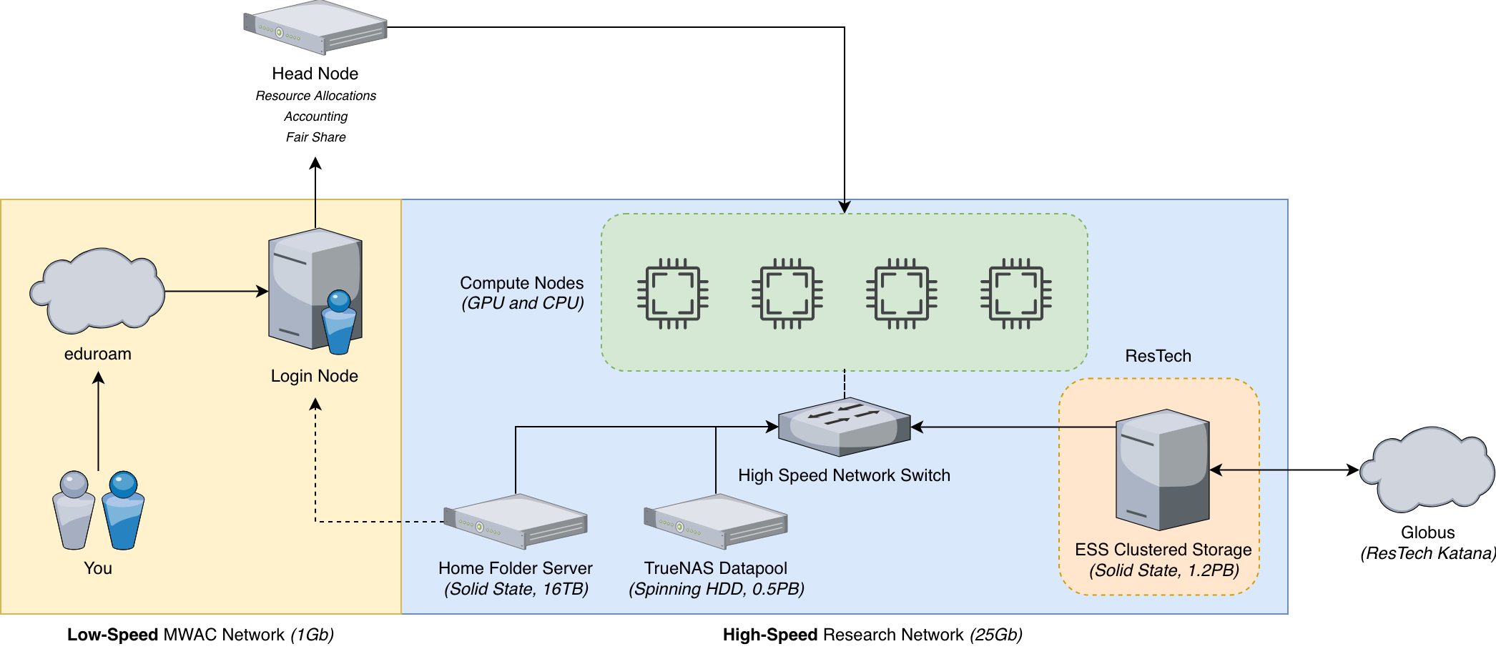
Cluster Architecture
Login node
The login node is how you access the compute cluster. It is a low resource node that can provide access to some cluster resources
On the login node, you can
Start, stop, and manage jobs
Access your home folder
Move small datasets to-and-from your home folder
Run persistent shell sessions
You cannot
Access your research data
Run compute workloads
Access a GPU
Copy large datasets

Slide 10
Cluster Architecture
Home Folder Server
This server contains your home directory. This data is yours and cannot be shared with anyone else. It is accessible at
/home/{Your zID}
Do keep in your home
Scripts
Logs
Documents
Configuration Files
Don’t keep in your home
Research data
Large shared datasets
Projects
Backups and snapshots
Nightly snapshots of your home folder are taken and backed up to an external data source. Snapshots are kept for 14 days. Files accidentally deleted, modified, or corrupted can be recovered within 14 days.
Usage and quota
Your home folder is on fast SSD storage. However, due it it’s (relatively) small size, your home folder is limited to 100GB in size by default. This limit can be increased temporarily, if your workload demands

Slide 11
Cluster Architecture
TrueNAS Datapool
This server is in the process of having it’s data moved onto the ESS. However, it is still used for training. It is accessible on compute nodes only at
/data/truenas
Do keep on the TrueNAS
Tutorial datasets
Tutorial projects
Intermediary files
Archive/backups of files in your home folder
Usage and quota
Due to it’s large size, the TrueNAS has no quota limitations. However, it is running spinning hard-disk drives, so access and data streaming may be considerably slower

Slide 12
Cluster Architecture
ResTech ESS
This data storage is managed by Research Technology. It is made of fast solid state flash storage It is accessible on compute nodes only at
/data/ess/
Do keep on the ESS
Collected datasets
Projects
Usage and quota
Usage and quota is handled by Research Technology. If you have collected data from a microscope at UNSW, it will be available on the ESS
Globus
Globus can be used to transfer research data into and out of UNSW over the internet. If you have collected data outside of UNSW, you can move it to UNSW via Globus.

Slide 13
Cluster Architecture
Head Node
The head node is what manages the entire compute cluster. It looks after resource allocations, and managed the queue when no resources are available
Billing & Accounting
This server keeps track of cluster usage per user and per billing account. If you are a member of the facility, this server will assist in automating the billing process
Fair Share & QoS
The cluster will provide “best effort” quality of service to ensure that there are always resources available. However, when the cluster is busy, your job may sit in queue. Fair Share ensures your job is priorities based on your past usage.

Slide 14
Cluster Architecture
Compute Nodes
These are the servers that perform work. They are equipped with powerful CPUs, GPUs, and a lot of RAM.
Resources
Currently, the cluster’s compute resources feature:
9 GPUs
176 CPU cores
386 GB of RAM

Slide 15


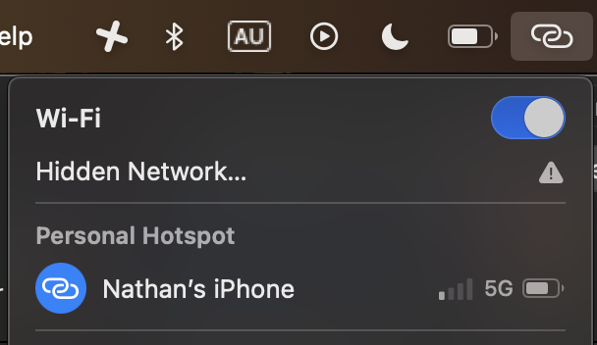

Accessing the cluster
Step 0: Ensure correct network connection
OR
(With UNSW Credentials)

Slide 16






Accessing the cluster
Step 1: Open a terminal application
MacOS
Windows
Linux
Terminal
Command Prompt
Your preferred
terminal emulator

Slide 17
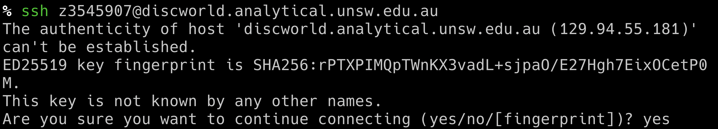
Accessing the cluster
Step 2: Connect to the login node

Slide 18
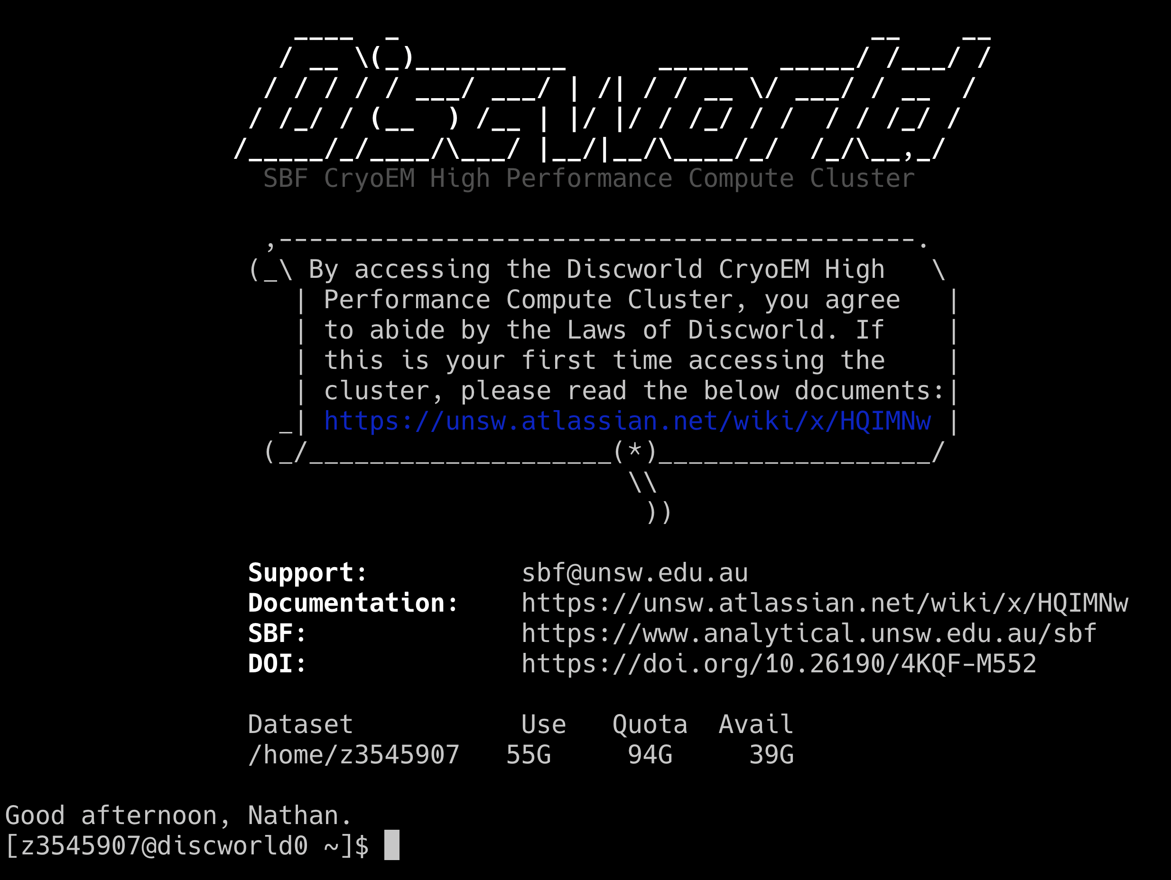
Accessing the cluster
Step 3: Success

Slide 19
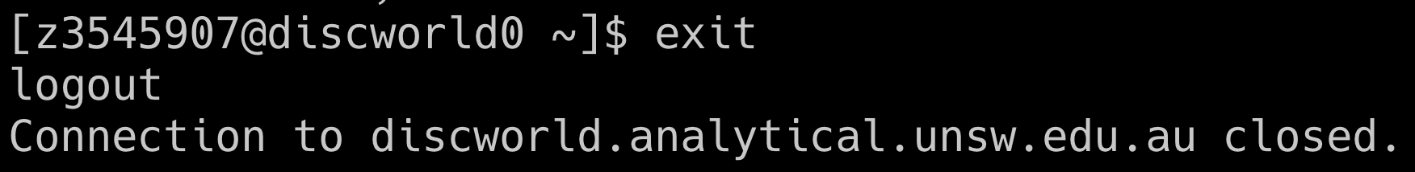
Accessing the cluster
Step 4 (Optional): Copy SSH keys to allow password-less connection

Slide 20
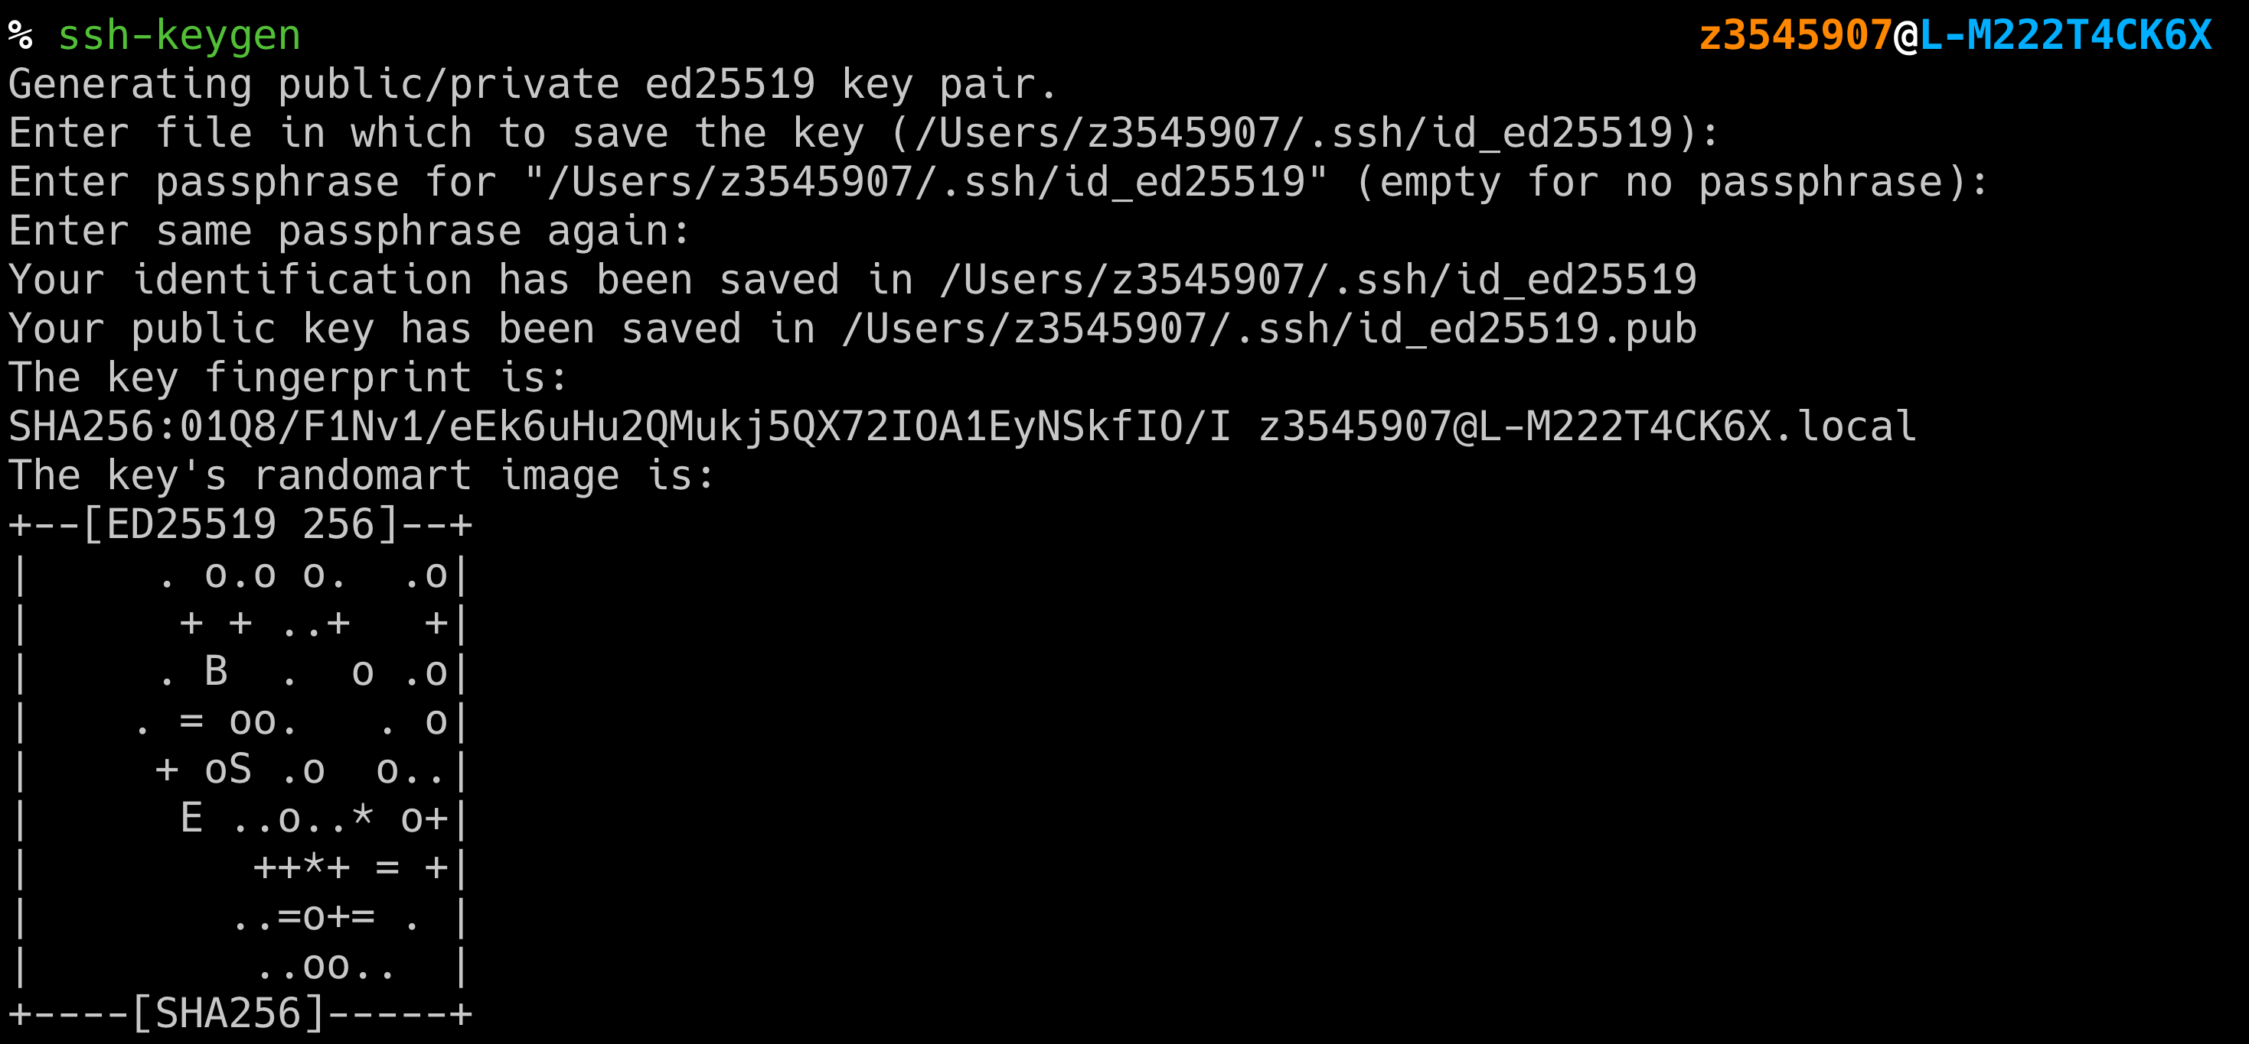
Accessing the cluster
Step 4 (Optional): Copy SSH keys to allow password-less connection

Slide 21
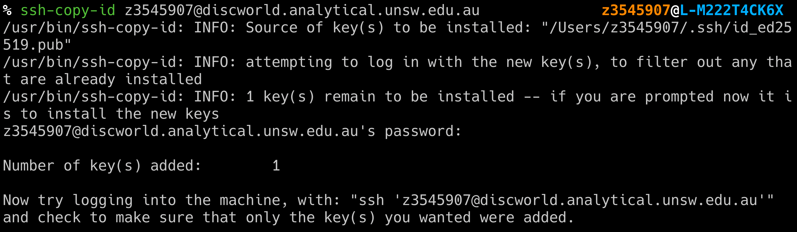
Accessing the cluster
Step 4 (Optional): Copy SSH keys to allow password-less connection

Slide 22
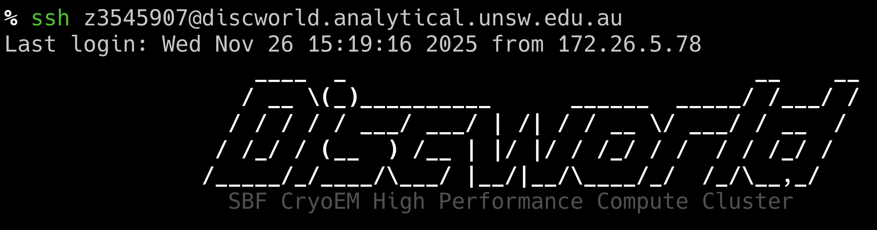
Accessing the cluster
Step 4 (Optional): Copy SSH keys to allow password-less connection

Slide 23
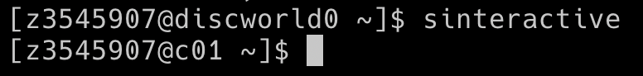
Accessing compute
Interactive Session
Note the change of the hostname. This shows that we are now on a compute node

Slide 24
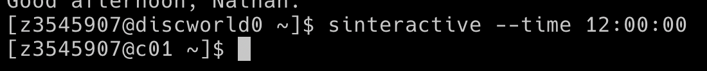
Accessing compute
Requesting longer sessions
This job will run for 12 hours

Slide 25
Accessing compute
Requesting more resources
This job will run for 4 hours with 16GB of RAM and 4 CPU cores

Slide 26
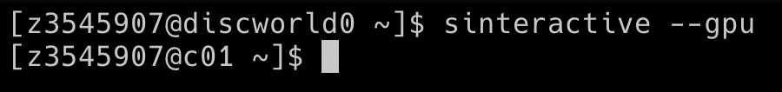
Accessing compute
Run with a GPU
This job will run with a GPU

Slide 27
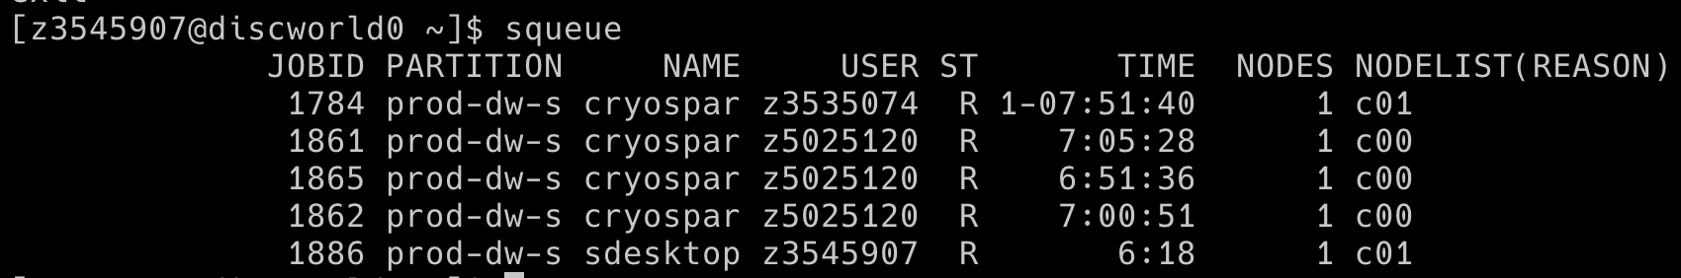
Accessing compute
Queue status
’squeue’ will show all jobs (running and queued) on the cluster

Slide 28
Accessing compute
Queue status (just my jobs)
’squeue --me’ will show all of your jobs (running and queued) on the cluster

Slide 29
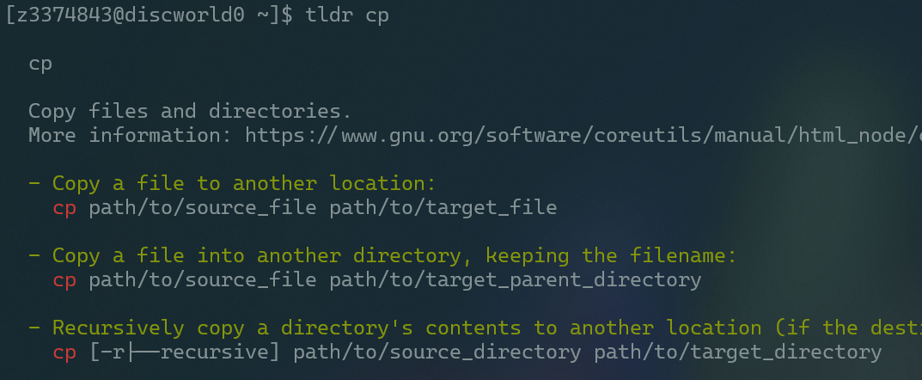
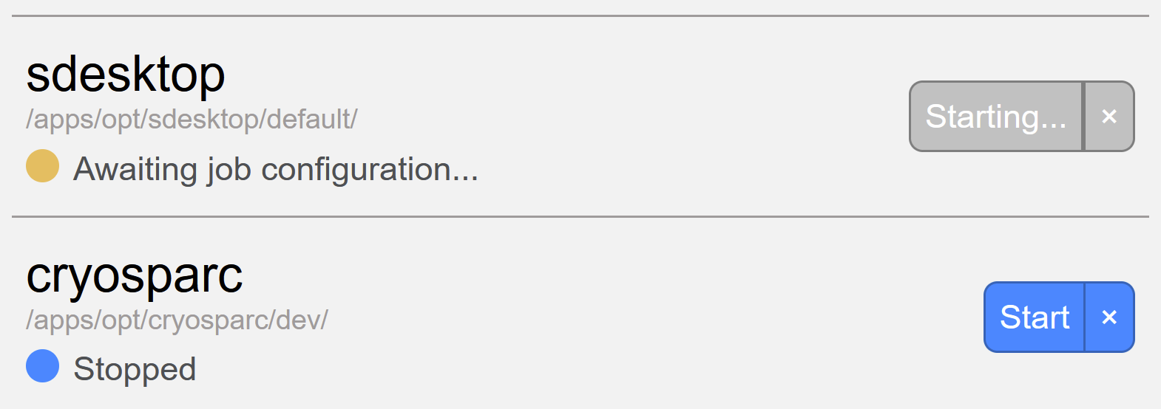
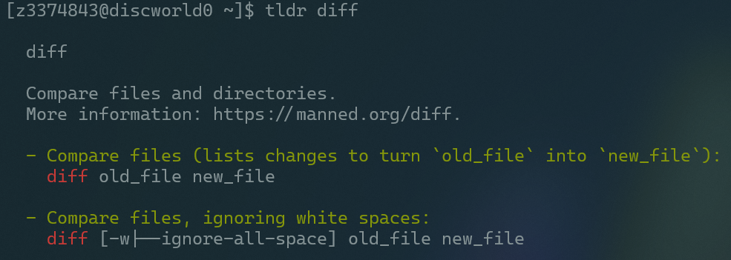
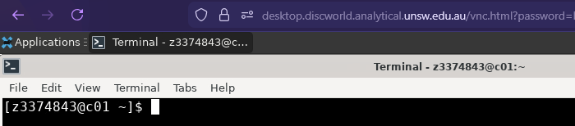
command line
tldr program • shows quick use
portal.discworld.analytical.unsw.edu.au
You can have 1 interactive graphical desktop open at once
(default desktop = no powerful GPU, just interface)
You can have as many command line terminals
(via sdesktop or SSH) open at once as you like
✨AI copilots
Are great at writing &
explaining typical tasks
We have tried to make the command line more readable than standard (zsh, default on Mac)
Can still run the 'typical' shell (bash program.sh) but look up zsh/our docs. 📧 We can change your shell

Slide 30


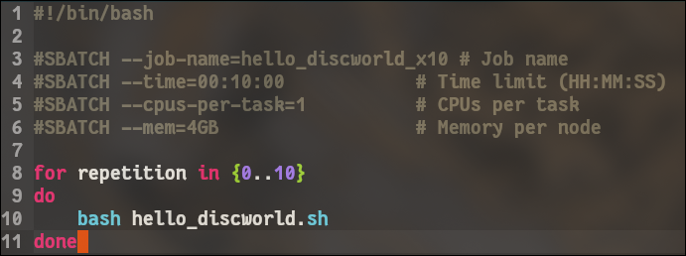
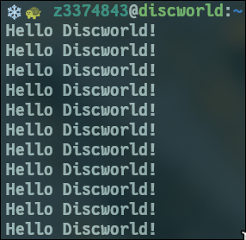
Text editing
Keeping things in text makes it simple to edit
Cntrl + S
References online
Cntrl + Q
The edit command opens an editor (micro) with common muscle-memory (not most efficient)
📖​
🐢
To save time with jobs, sdraft creates a template – you edit in the details
Discworld User Docs
unsw. atlassian.net/wiki/spaces/DUD/overview

Slide 31
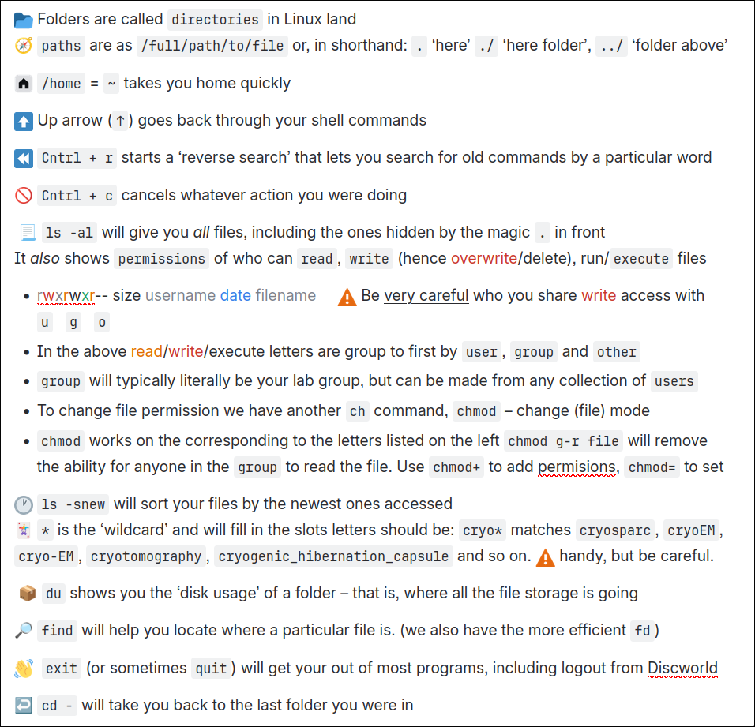
Command-line tools
Way faster for day-to-day tasks with big datasets
You're in control – of managing personal data. Includes permissions & rm Remember – still have file browser in sdesktop
References online
📖​
🐢
Discworld User Docs
unsw. atlassian.net/wiki/spaces/DUD/overview

Slide 32
Live work & support time
(we have the room all day) 🐢❄️ -🌐🐧🧑‍💻👩🏾‍💻👨🏻‍💻👩‍💻👩🏿‍💻🧑🏼‍💻👨🏾‍💻

Slide 33
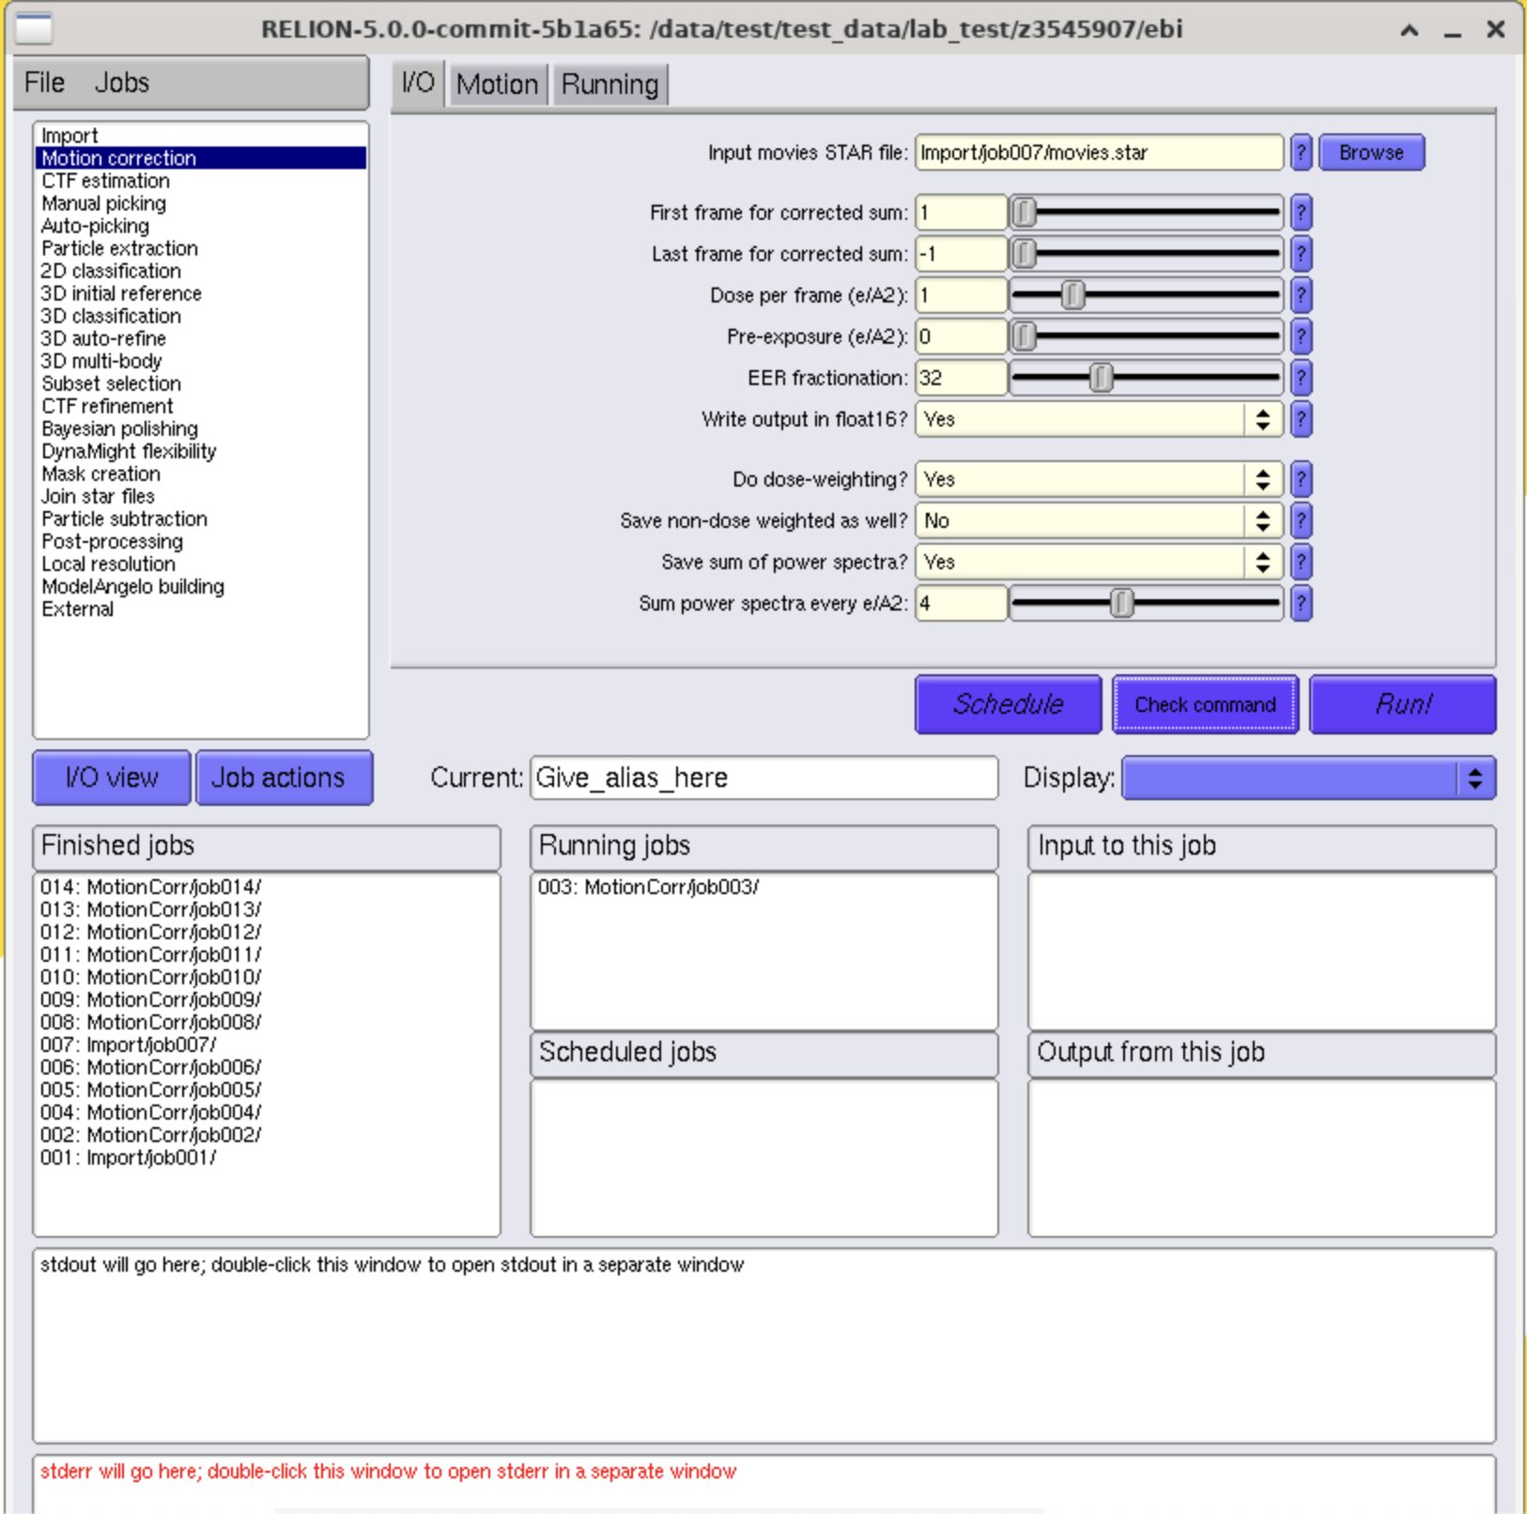
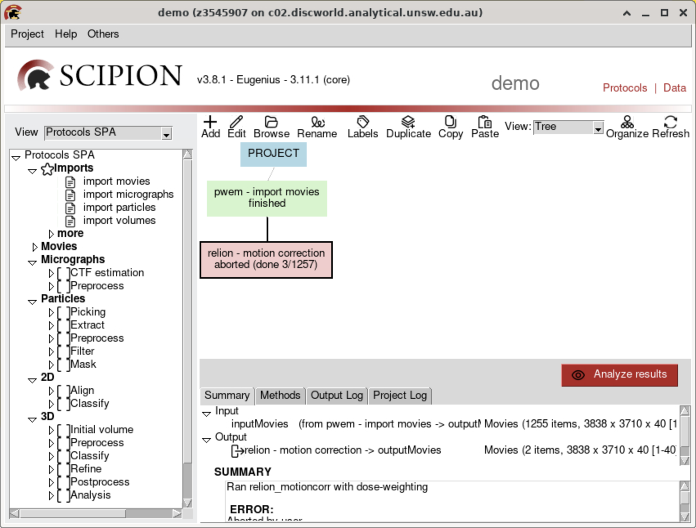
Running Jobs

Slide 34
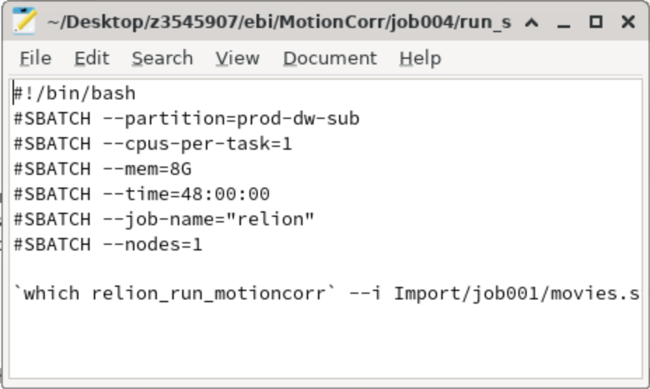
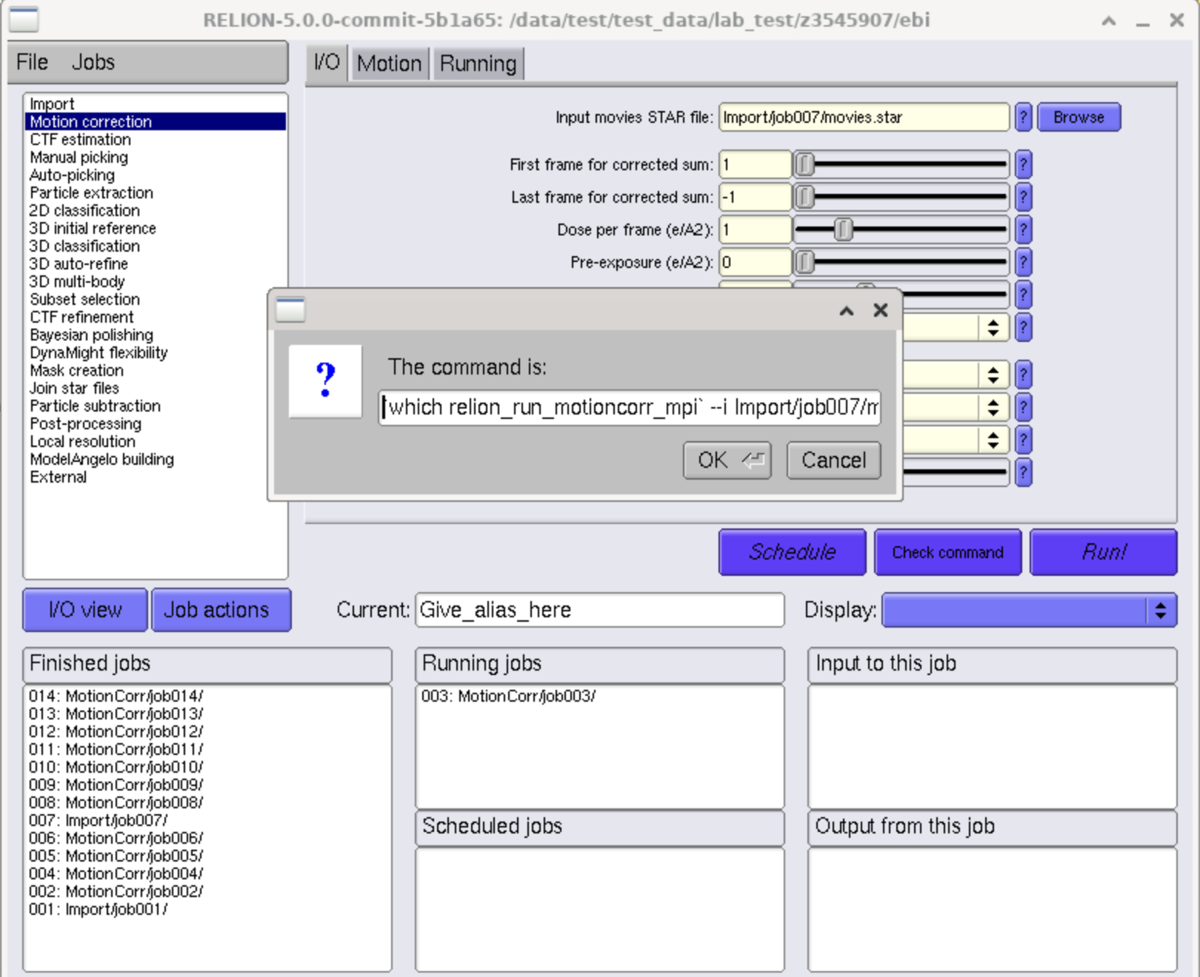

What is actually going on
Under the hood, these applications are just a front-end to constructing jobs. You can see this best in RELION.
The check command button and run_submit.script files show us what is really going on. Under the hood, its just running commands on the compute cluster.

Slide 35
What if we did this ourselves?
This probably raises some questions:
How would I do this?
Why would I want to do this?
When should I do this?

Slide 36
Batching and array jobs

Slide 37
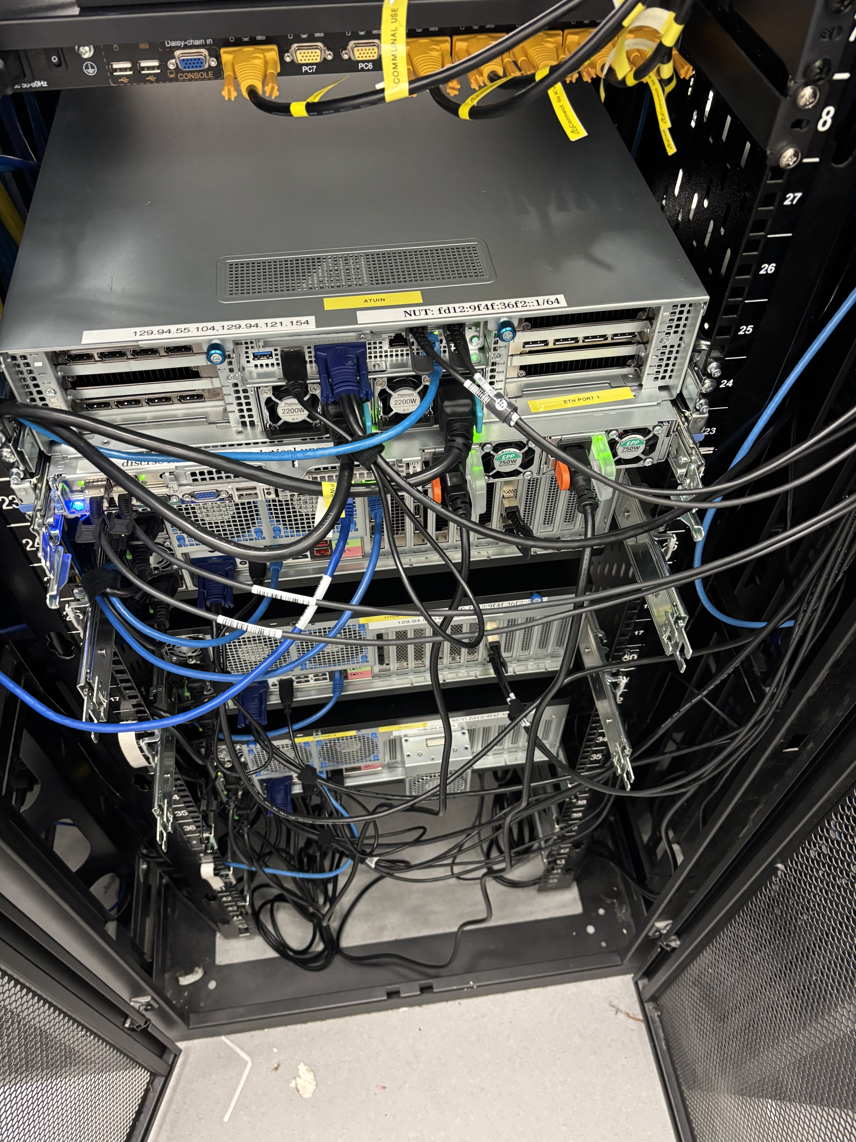
Understanding the benefits
BUT…
A cluster is a big pool of resources
A cluster is still made up of individual computers. These computers have limits

Slide 38
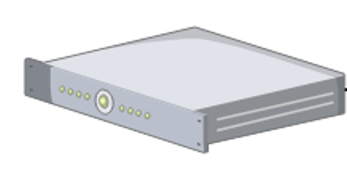

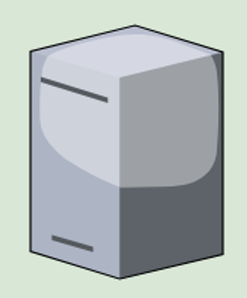
Understanding the benefits
“Okay! Your job ID is 1234”
”Run this job for me, please”
1 GPU
4 CPUs
64 GB RAM
2 GPUs
64 CPUs
64 GB RAM
2 GPUs
64 CPUs
64 GB RAM
2 GPUs
64 CPUs
64 GB RAM
2 GPUs
64 CPUs
64 GB RAM

Slide 39
Understanding the benefits
“Okay, your job is waiting in queue”
”Actually, this is a small job. I can start it now, and it won’t affect other’s wait times”
”Please run this job for me”
1 GPU
4 CPUs
16 GB RAM
2 GPUs
64 CPUs
64 GB RAM
2 GPUs
64 CPUs
64 GB RAM
2 GPUs
64 CPUs
64 GB RAM
2 GPUs
64 CPUs
64 GB RAM
1 GPU
16 CPUs
16 GB RAM
1 GPU
16 CPUs
16 GB RAM
1 GPU
16 CPUs
16 GB RAM
1 GPU
16 CPUs
16 GB RAM

Slide 40
Understanding the benefits
“Sorry, I can’t fit this job anywhere!”
”Run this job for me, please”
8 GPU
256 CPUs
256 GB RAM
2 GPUs
64 CPUs
64 GB RAM
2 GPUs
64 CPUs
64 GB RAM
2 GPUs
64 CPUs
64 GB RAM
2 GPUs
64 CPUs
64 GB RAM

Slide 41
Array job?
”This job is done now.”
“Okay, your job is waiting in queue”
”Run this 9x array job for me, please”
1 GPU
4 CPUs
16 GB RAM
x9
2 GPUs
64 CPUs
64 GB RAM
2 GPUs
64 CPUs
64 GB RAM
2 GPUs
64 CPUs
64 GB RAM
2 GPUs
64 CPUs
64 GB RAM

Slide 42
Array job?
From this array job, we got to use:
1 GPU
4 CPUs
16 GB RAM
x9
9 GPUs
36 CPU cores
144 GB of RAM
As a single job, this could not fit on a single compute node. But the job still ran, since it was structured as an array job.
2 GPUs
64 CPUs
64 GB RAM

Slide 43
Structuring an array job

Slide 44

Traditional ”Monolith” job
samplesheet.csv
Sample ID | Path
0 | /data/ess/z1234567/samples/0.fasta
1 | /data/ess/z1234567/samples/1.fasta
2 | /data/ess/z1234567/samples/2.fasta
3 | /data/ess/z1234567/samples/3.fasta
4 | /data/ess/z1234567/samples/4.fasta
Alignment Job (Job ID 1234)
Output
Will generate an alignment for each sample one-by-one.
for i in samples:
mmseqs_align(i, output_path)
On a small scale, this works okay. But what if we had 100 samples, or 1000 samples?

Slide 45
Array job
samplesheet.csv
Sample ID | Path
0 | /data/ess/z1234567/samples/0.fasta
1 | /data/ess/z1234567/samples/1.fasta
2 | /data/ess/z1234567/samples/2.fasta
3 | /data/ess/z1234567/samples/3.fasta
4 | /data/ess/z1234567/samples/4.fasta
Alignment Job (Job ID 1234)
1234_1
Output
1234_2
1234_3
1234_4
1234_5
Jobs can be run simultaneously
(Given available resources)

